Slide 1
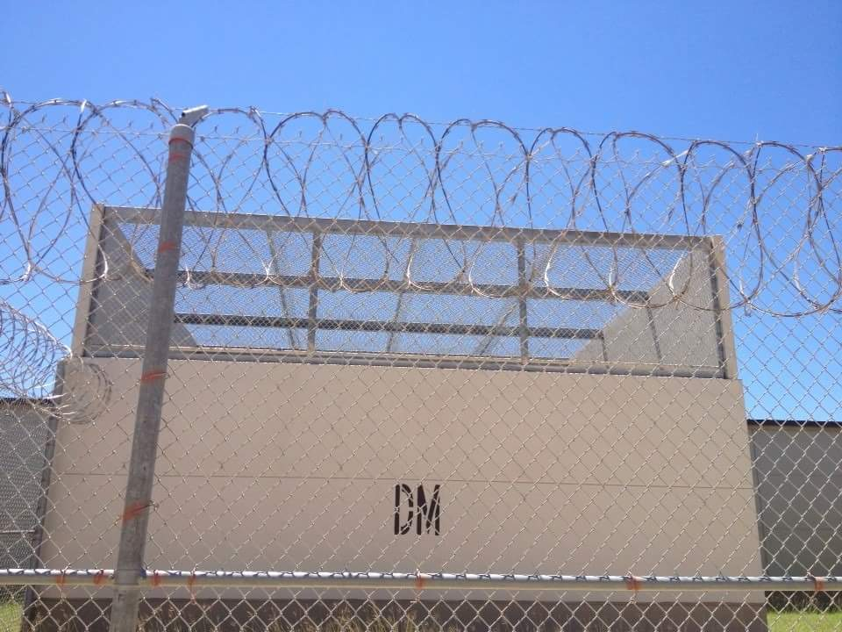
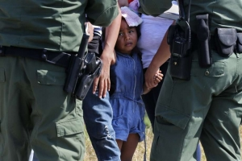

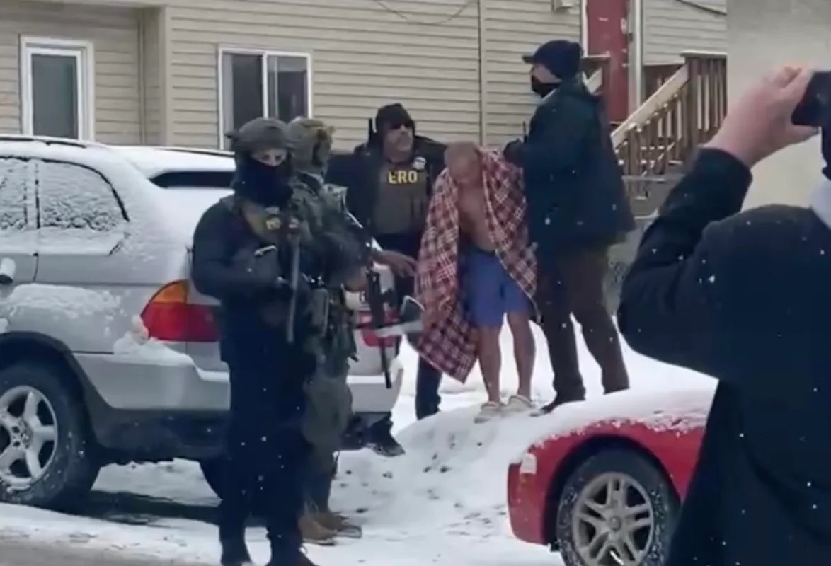
i.c.e. kidnappings and the new York stock exchange
May 20, 2026, noon
Rotary Club of South Austin
Austin, Texas
Talk by Elvia R. Arriola, Founder
Women on the Border
Notes:
Left up: Happy mood at the New York Stock Exchange
Left down: Barbed wire at Pearsall detention center, San Antonio
Right up: Child caught in the midst of an ICE raid of family home z
Right down: ICE mistakenly arrests an Asian-American U.S. citizen

Slide 2
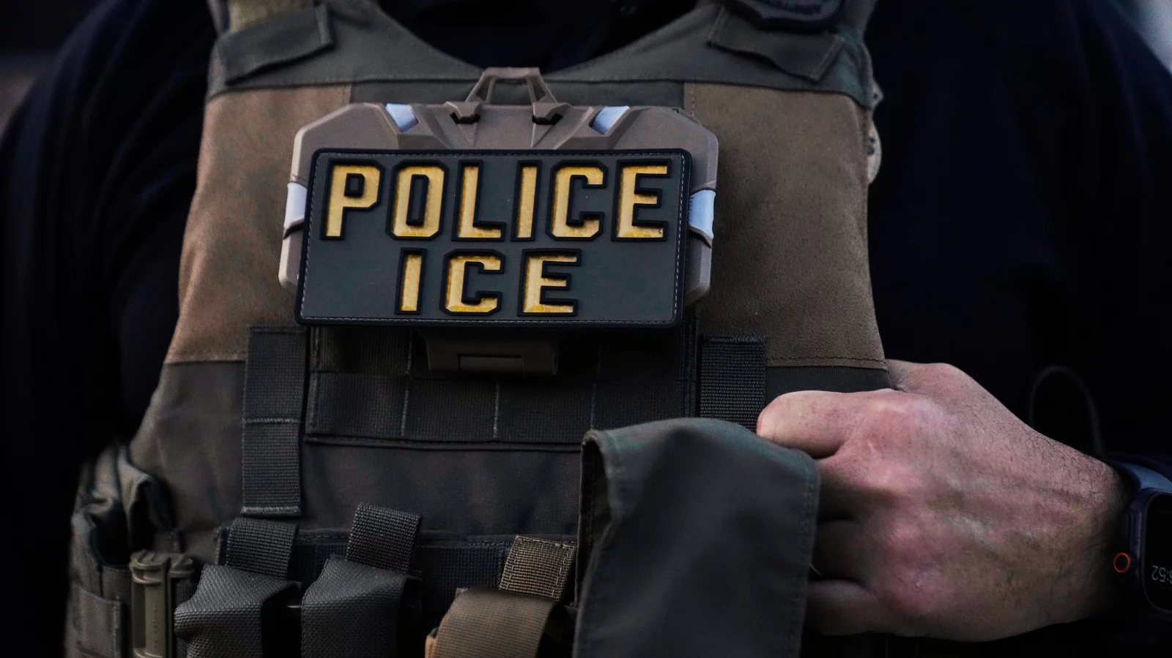
It is an agency created by merging the former CBP and INS. $85 billion in federal funds; larger budget than all federal agencies combined.
ICE is under DHS; it isn’t a police force; it is enforcement arm that can arrest and detain anyone believed to be in the U.S. illegally
Trump in Jan. 2025 immediately shut down all legal forms of entry –terminated the CBP OneApp (for schedule appointments with immigration authority) and ICE authorized to go after people who arrived as refugees seeking asylum or as citizens of Cuba, Haiti, Nicaragua and Venezuela.

Slide 3
The i.c.e. Arrest
- Is it legal? Is it a kidnapping?
THE AUTHORITY TO DETAIN, ARREST AND PROCESS FOR REMOVAL:
-Trump promised “mass deportation”
- all migrants without proper documentation are presumed to be “illegal aliens”
-Trump said “go after the murderers and criminals”
- record of infraction, trigger arrest (parking tickets, missed immigration appointment, failure to renew vehicle registration)
ACTUAL DATA:
-as of last month 42,000 people held in detention have no criminal record whatsoever
-this is “over 70% of the 60,311 held in custody
-American Immigration Council: At least 50,000 in custody or detention had pending applications, are long-term residents, have no criminal record
VIOLENCE – why?
- Trump wants migrants out
- DHS/ICE authorities don’t want protest
- Racial profiling is ok according to the Supreme Court (Noem v. Vasquez)

Slide 4
HOW IS THE ARREST PERFORMED
- masks, stun guns, guns that kill, early hours or late at night (2 a.m. here in Austin)
DAY CARE WORKER
“LOOKS” LIKE AN UNDOCUMENTED
Leonardo Garcia Venegas: A U.S. citizen construction worker in Alabama was detained twice by ICE in 2025 despite providing proof of citizenship, with allegations that agents rounded up workers who "looked Latino" at construction sites.
Jensy Machado: A U.S. citizen in early 2025 was detained at gunpoint by ICE agents who handcuffed him and questioned his legal status while searching for another individual.
Andrea Velez: A U.S. citizen in Los Angeles was knocked to the ground and arrested during an immigration raid in summer 2025, later spending two nights in jail before felony charges were dropped.
Miguel Angel Ponce Jr.: A Houston man was pulled over, handcuffed, and detained for two hours in 2025 because he "looked like someone they were looking for," later confirmed to be a case of mistaken identity.
15-Year-Old Student: A 15-year-old U.S. citizen with disabilities was handcuffed at gunpoint outside a high school in 2025 based on his appearance, according to social media documentation of the incident.

